Slide 1
Cancer Biology Biol 445
Spring 2020
Dr. Heidi Super
Lecture 21
3-23-2020

Slide 2
Where were we
Back to viruses (Chapters 4 and 7)
In general, linking a pathogen to a disease takes careful step-wise proof.
Robert Koch is the Father of the the Germ Theory.
He was a microbiologist who put forth postulates for determining a particular organism caused a disease. Review and explain Koch’s postulates.

Slide 3
Linking viruses to cancer
Koch’s criteria are easy to put to the test in non-human animals.
Early tests showed animals (birds, rodents, amphibians) can/do harbor viruses which cause cancer.
Leukemia
Sarcoma
carcinoma
Lymphoma

Slide 4
Peyton Rous’s work—1910 First to show a viral link to cancer in animals. Virus came to be called Rous Sarcoma Virus (RSV)
Keeps whole cells from being transmitted to new host.
Figure 3.2 The Biology of Cancer (© Garland Science 2007)

Slide 5
Koch’s criteria are not so easy to put to the test in humans. Why?
Initially…
Medical ethics—can’t infect human subjects with a potentially lethal agent
Lack of technology to detect infectious agents in naturally-occurring human cancers.

Slide 6
Eventually…
Even with molecular biology advances allowing detection of genetic material from bacteria and viruses, few human cancers showed a link to pathogens.

Slide 7
A few exceptions
Viruses
Bacteria and Parasites
Heliobacter pylori
Parasitic worms– blood and liver flukes
HVP (only a few strains)
HTLV-1
Hepatitis B and Hepatitis C viruses
Epstein Barr virus
Kaposi sarcoma virus

Slide 8
Let’s continue with retroviruses
RSV originated when a chicken virus (avian leukosis virus—ALV) acquired he Src proto-oncogen from a specific chicken’s cell.

Slide 9
Figure 3.19 The Biology of Cancer (© Garland Science 2007)

Slide 10
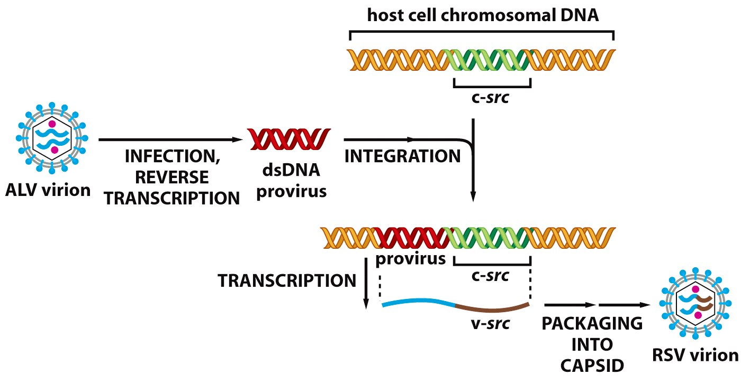
Mechanism?
Figure 3.22 The Biology of Cancer (© Garland Science 2007)

Slide 11
Figure 7-8,7-9,
Figure 7-10
Table 7-3

Slide 12
Amazing set of circumstances.
The creation of the RSV virus seems to have occurred only once in the 20th century!
All RSV descendants can be traced to a single chicken coop in 1909.
From where?....A farmer brought Rous a prize hen hoping he could cure her cancer!

Slide 13
Evidence?...
Genetic (Sequence) similarity of all RSV isolates
Picking up additional genes usually decreases the ability of a virus to infect host cells. (That virus will die out quickly—will be lost from the population)

Slide 14
For oncogenic retroviruses to be maintained:
Someone (like Rous) has to notice cancer in an animal and artificially propagate the virus!
The virus must gain something…e.g. an increased ability to infect a new host.

Slide 15
A second chicken virus, MC29, was also shown to be a modified ALV.
In MC29, ALV acquired Myc (not Src) from a chicken cell.
Both Rous Sarcoma Virus (RSV) and MC29 cause cancer soon after infection of the animal’s cell.

Slide 16
All retroviruses that rapidly induce cancer in animals have been shown to have acquired a cellular oncogene.= acutely transforming retroviruses.
Without these viruses, the identification of protoncogenes would have been much more difficult! This is a recurring theme!

Slide 17
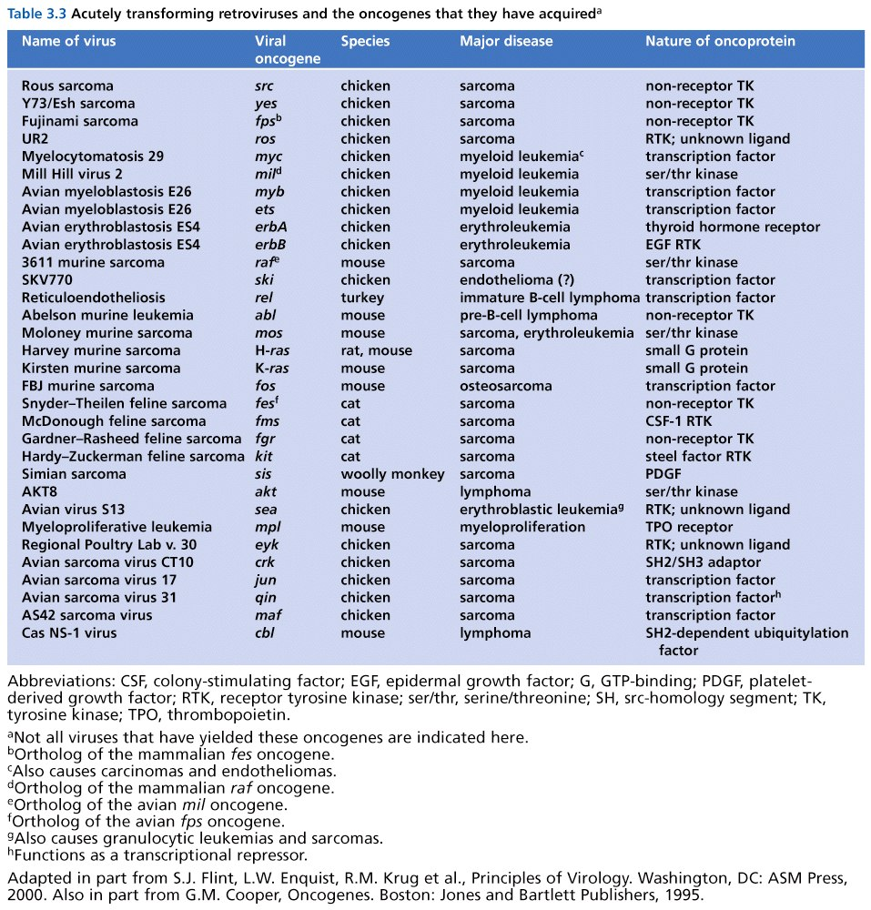

Slide 18
Some retroviruses induce cancer, but slowly. (after long-term infection).
Interestingly…these viruses do not contain cellular host genes.
Eventually, tumor cells were found to have retroviral insertion near cellular proto-oncogenes.

Slide 19
We’ve heard about this….
Insertion results in altered expression or altered mRNA/protein made by the proto-oncogene.
=Insertional Mutagenesis

Slide 20
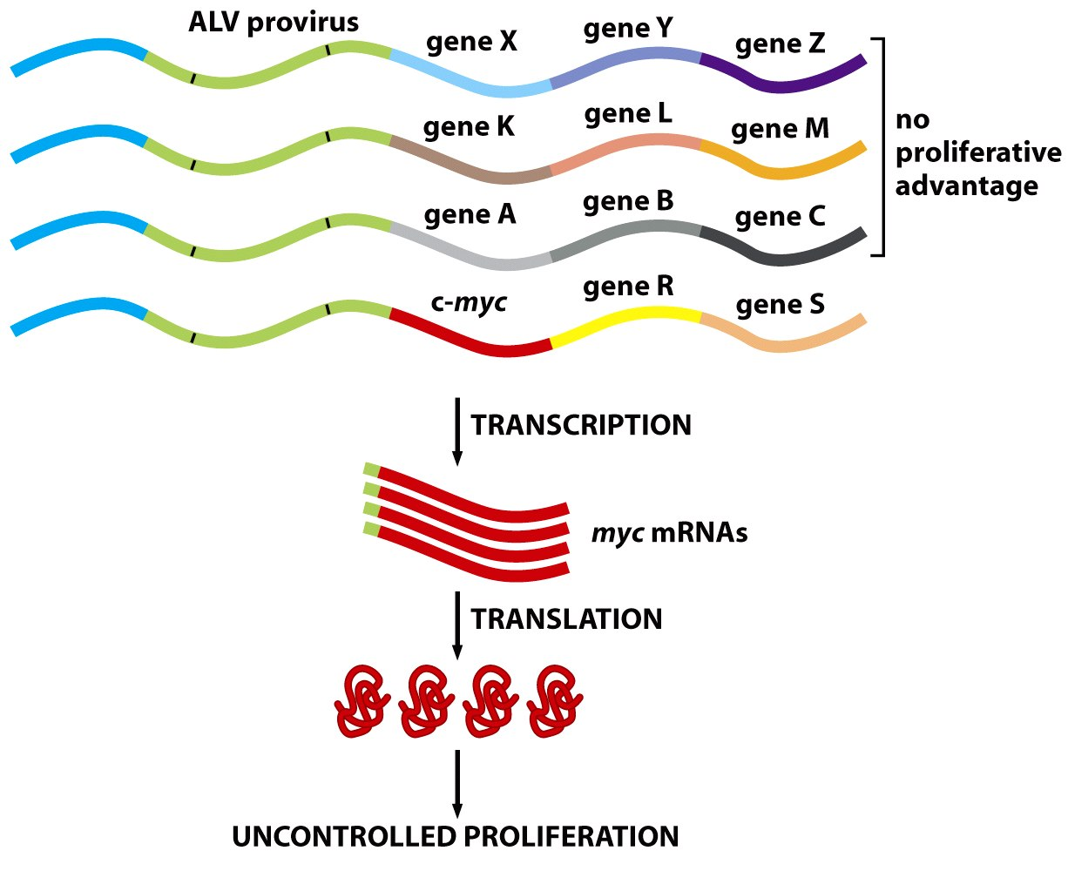
Figure 3.23b The Biology of Cancer (© Garland Science 2007)

Slide 21
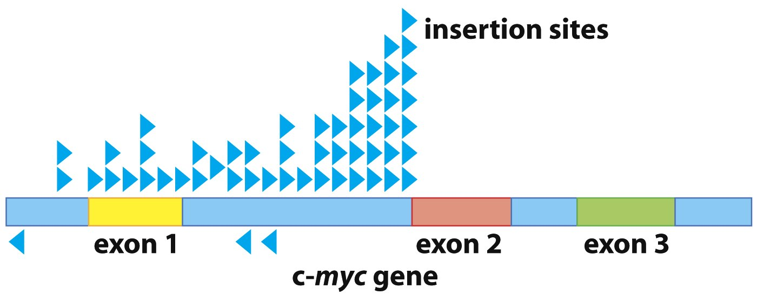
Certain sites of insertion to be more advantageous to the virus than other sites of insertion. Blue arrows indicate cancer causing viruses and where in the Myc gene the virus inserted.
Figure 3.23a The Biology of Cancer (© Garland Science 2007)

Slide 22
Isolation of DNA near the insertion site of retroviruses has allowed mapping of new, or previously identified proto-oncogenes.

Slide 23
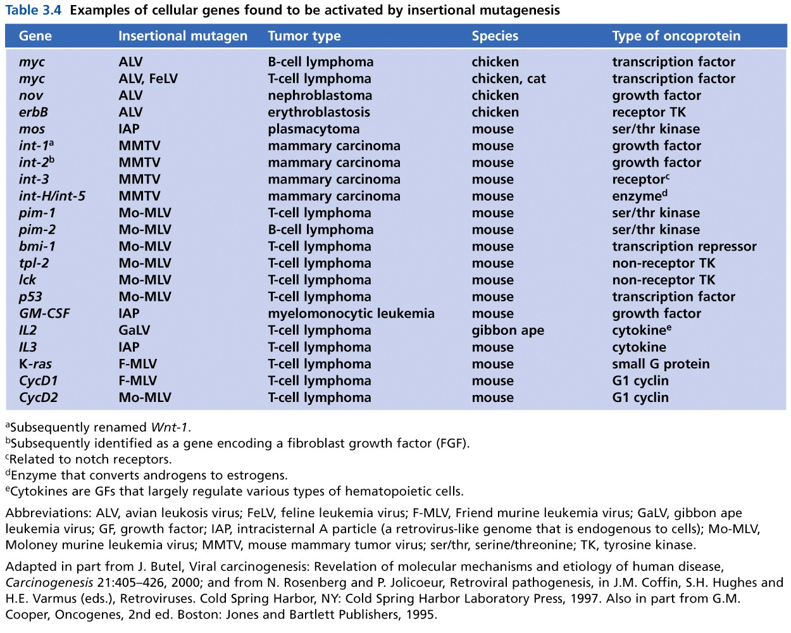
Table 3.4 The Biology of Cancer (© Garland Science 2007)

Slide 24
Variation in cancer viruses Table 7-1
Genome
RNA—retroviruses,
DNA (HPV)
Cancer specificity
Linked to one type of cancer
Linked to several tumor types
Activity
Immediate (acutely transforming)
Latent (long-term infection before cancer develops)

Slide 25
Some other viruses have a tight correlation to human cancers, but play an indirect role.

Slide 26
Epstein-Barr virus
~90% of people world-wide have been infected with EBV (Herpes family virus)
Associated with infectious mononucleosis
Readily infects lymphocytes
High correlation of EBV and Burkitt’s lymphoma (limited to equatorial Africa)
Found in ~50% of Hodgkin’s lymphoma (characterized by an unusual lymphocte)

Slide 27
A complicated link to human cancer
Burkitt’s lymphoma occurs where mosquitoes are abundant and malaria is prevalent.
Infection with malaria suppresses the immune system and likely allows EBV to proliferate and exert effects on cells, not possible in a human with robust immune response.

Slide 28
Clearly, most people who have been exposed to EBV do not develop lymphoma.
Having mononucleosis does slightly increase the risk for developing lymphoma, including Hodgkins lymphoma.

Slide 29
EBV also linked to head and neck cancers
Limited regionally (southeast Asia)
Nasophryngeal carcinoma (nose/throat)
Means that EBV is not entirely specific for lymphocyte infection. And that an environmental factor likely contributes to these cancers.

Slide 30
How do we link EBV (or any infectious agent) to cancer? Follow Koch’s postulates!
EBV genome/proteins found in the cancer cells, but not in other cells of the organism.
Remember---Cancer is nearly always as somatic, genetic disease. Mutations/cause is limited to the cancer cells.

Slide 31
Lecture 21--Part II

Slide 32
Molecular mechanism of EBV?
Unknown…
Likely indirect
Suppression of immune system
Inhibition of cancer-associated genes?
EBV expresses a protein which binds to a cellular protein Nm23H1. Nm23H1 inhibits migration of cells (belongs to a class of genes called metastasis-inhibitor genes.
Still being studied…

Slide 33
Oncogenic Epstein-Barr virus recruits Nm23-H1 to regulate chromatin modifiers. Pandey S^{1,2}, Robertson ES^{1,2}. Author information Lab Invest. 2018 Feb;98(2):258-268. doi: 10.1038/labinvest.2017.112. Epub 2017 Oct 16
Abstract
In cancer progression, metastasis is a major cause of poor survival of patients and can be targeted for therapeutic interventions. The first discovered metastatic-suppressor Nm23-H1 possesses nucleoside diphosphate kinase, histidine kinase, and DNase activity as a broad-spectrum enzyme. Recent advances in cancer metastasis have opened new ways for the development of therapeutic molecular approaches. In this review, we provide a summary of the current understanding of Nm23/NDPKs in the context of viral oncogenesis. We also focused on Nm23-H1-mediated cellular events with an emphasis on chromatin modifications. How Nm23-H1 modulates the activities of chromatin modifiers through interaction with Epstein-Barr virus-encoded oncogenic antigens and related crosstalks are discussed in the context of other oncogenic viruses. We also described the current understanding of the cellular and viral interactions of Nm23-H1 and their reference to transcription regulation and metastasis. Further, we summarized the recent therapeutic approaches targeting Nm23 and its potential links to pathways that can be exploited by oncogenic viruses.

Slide 34
Other viruses linked to cancers
1. HIV is linked to Kaposi sarcoma (KS). In most populations this mostly cutaneous cancer is very rare and only associated with immunosuppression.
AIDS-related Kaposi sarcoma is the result of HIV immunosuppression. People developing AIDS cannot fight off another virus---Human Herpes Virus 8 (HHV8). (A doctor, Mortiz Kaposi, first proposed this hypothesis)

Slide 35
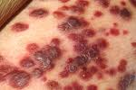

Slide 36
HHV8 mechanism
HHV8 encodes several oncogenes (one that behaves like a cellular cyclin protein.)
HHV8 encodes some proteins that inhibit p53.
---Again we see a virus that affects 2 key players in cell proliferation!

Slide 37
KS has a “2-virus link”
In most cases of KS, HIV acts indirectly to allow HHV8 infection to become established.
HHV8 directly transforms cells the cells it infects.

Slide 38
HIV/AIDS increases risk for other cancers too
Once again we see that immunosuppression (by any means) increases cancer risk.
Figure 7-5 (and review figure 2-22)

Slide 39
Hepatitis viruses
Hepatitis is inflamation of the liver.
Causes? Alcohol, parasites, viruses
2 viruses linked to hepatitis, then liver cancer
Hepatitis B virus-DNA genome
Hepatitis C virus-RNA genome (not a retrovirus

Slide 40
Hepatitis B virus (HBV)
Most virus-associated liver cancer involves HBV
Transmitted via blood or other body fluids (STD, needle sharing, or transfusions)
Interesting distribution, worldwide. 7-4

Slide 41
Hepatitis C virus (HCV)
Not easily transmitted sexually. Main transmission via shared needles and transfusions—not discovered until 1988 so blood products contaminated until ~1990.
HCV actually better than HBV at establishing long-term chronic infection—more people in USA infected with HCV.

Slide 42
Chronic infections…
Call in immune system cells to the damaged tissue.
Visible with PATHOLOGY techniques.

Slide 43
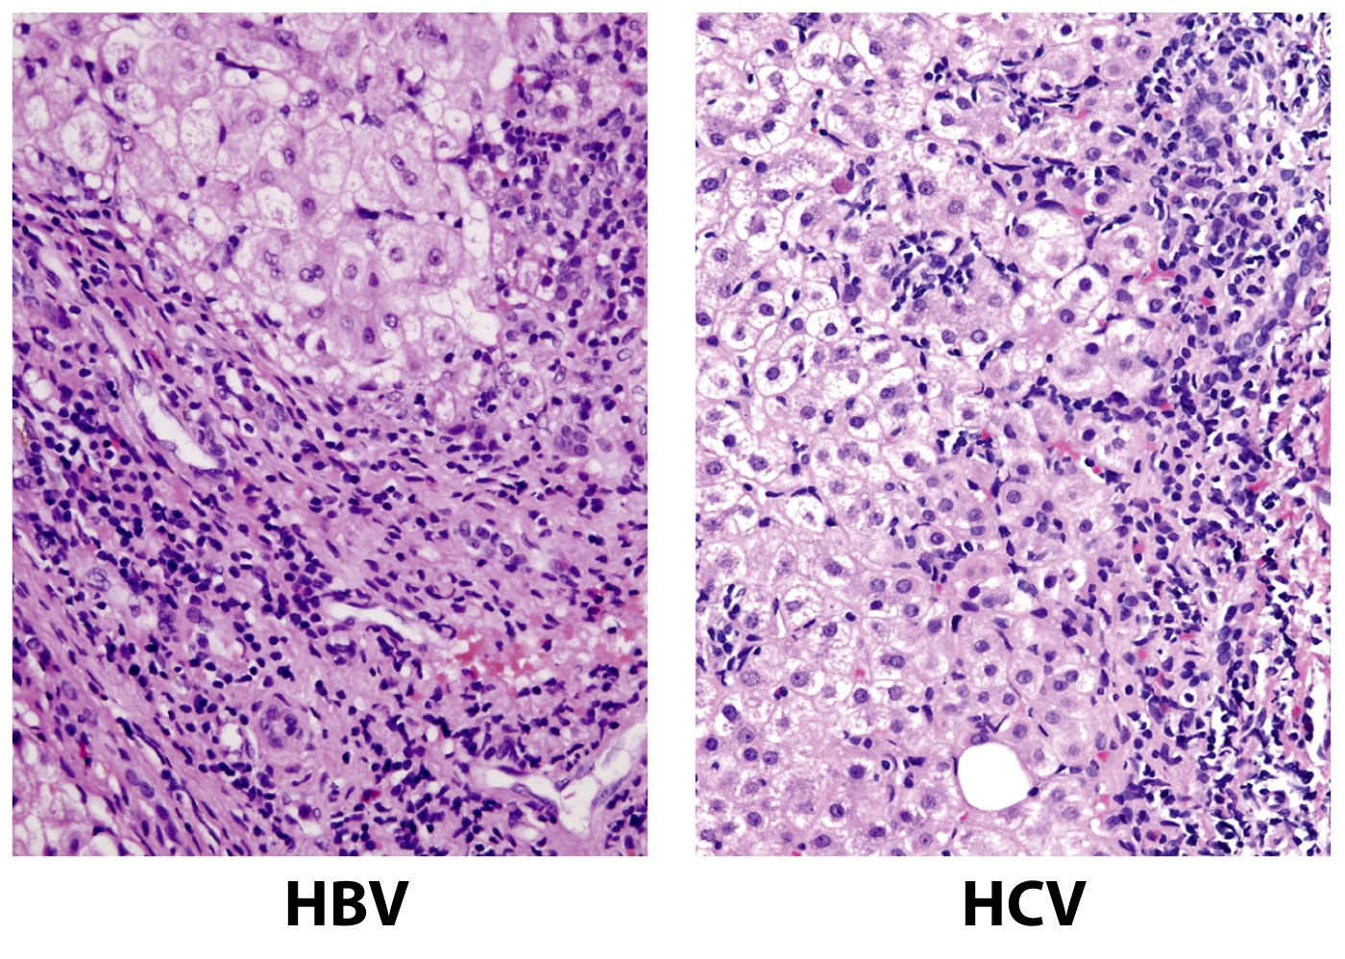
What is this staining technique?
Figure 11.35b The Biology of Cancer (© Garland Science 2007)

Slide 44
Hepatocytes
Lymphocytes
Hepatocytes
Lymphocytes
Figure 11.35b The Biology of Cancer (© Garland Science 2007)

Slide 45
How do HBV/HCV cause cancer?
1. Establishing long term, chronic infection
2. Infection directly damages tissue. Uninfected cells stimulated to proliferate. Anything that increases cell proliferation, increases the chance for acquiring mutations.

Slide 46
3. Tissue damage triggers immune response.
Infiltration of lymphocytes and macrophages.
These WBCs act in 2 ways to contribute to cancer.
A. Release cytotoxic chemicals such as oxygen free radicals. Kill pathogens, but also act as mutagens. With increased proliferation, increases the chance that new tissue cells will acquire DNA damage
B. Release factors such as NF-kappa B, which activates transcription of genes that stimulate cell division and inhibit apoptosis.

Slide 47
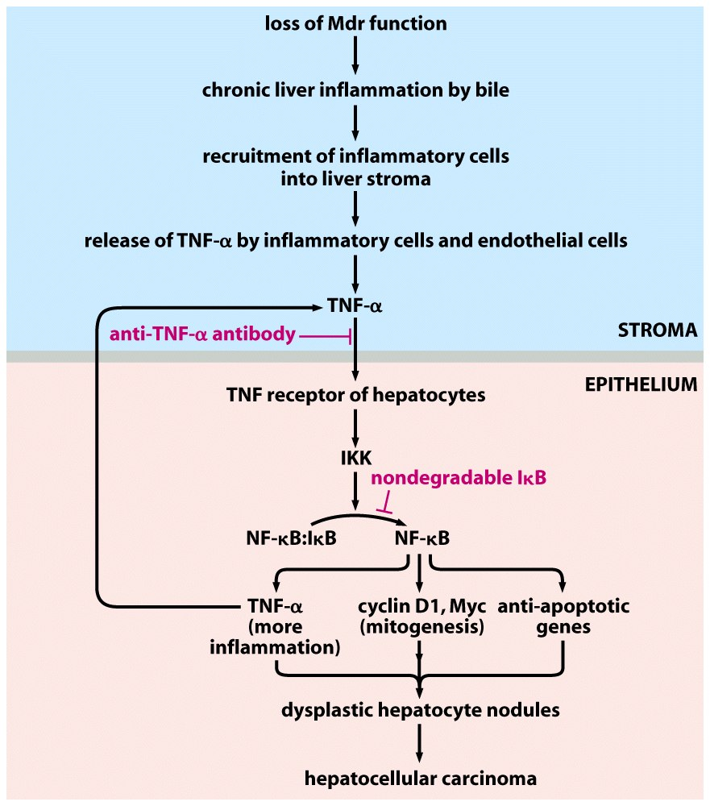
Figure 11.37b The Biology of Cancer (© Garland Science 2007)

Slide 48
Figure 11.37b The Biology of Cancer (© Garland Science 2007)

Slide 49
Chronic infections with HVB and HVC set up conditions which increase the likelihood that multiple mutations occur in the same liver cell.

Slide 50
More cancer links to inflammation…
Stomach cancer---Linked to ulcer-causing bacterium Heloicobacter pylori.
~50% infection world-wide.
Stomach cancer requires prior exposure to H. pylori.
Stomach cancer 2nd only to lung cancer incidence world-wide
Elimination of H. pylori with antibiotics greatly reduces stomach cancer incidence.
Specific diets (high salt) greatly increase stomach cancer incidence

Slide 51
Mechanism?...
Same as HBV/HBC in some aspects
General effect of cell damage, infiltration of immune system cells.
-More specific mechanism—expression of H. pylori protein called CagA. CagA stimulates cell division in epithelial cells of stomach lining.

Slide 52
Flatworm infections
Blood flukes and liver flukes (tremotodes)
Blood flukes carried by fresh water snails---cause shistosomiasis ---common in Africa, South America
Bathing in water with high snail count allows larvae to enter skin. Worms mature and live in bladder and intestine. Chronic infection/inflammation.
Blood fluke infection linked to bladder cancer.

Slide 53
Liver Fluke
Contract by eating raw or undercooked fish.
Parasite lives in bile ducts of the liver and induces inflammation there.
Linked to rare bile-duct cancer (common in regions of Asia, where liver fluke common).

